Slide 1

Robots in Disguise: Neural Networks
3rd April 2023
J. Roberts | P. Swatton

Slide 2
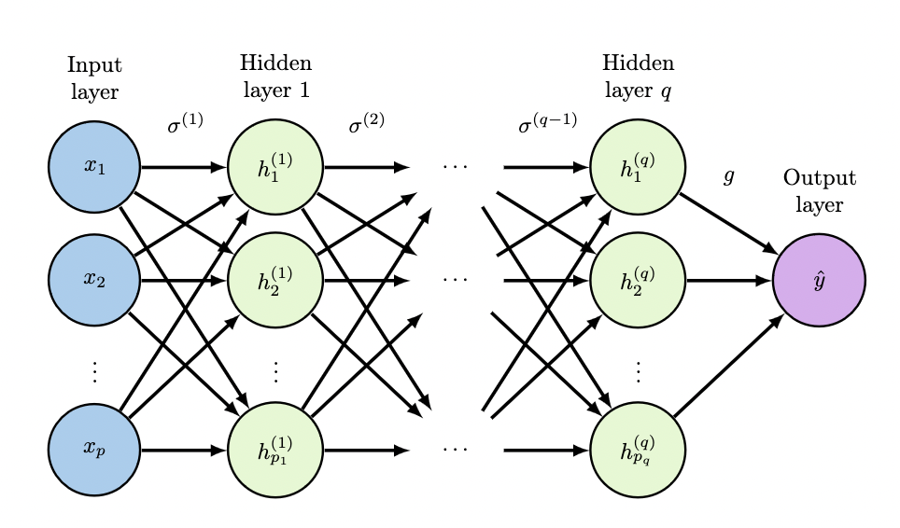
Introduction
Neural Networks vs Deep Learning
What we’ll cover:
History of neural networks
How they work
Activation functions (maybe)
Why they work (kind of)
An example implementation (maybe)
Some common architectures (maybe)

Slide 3
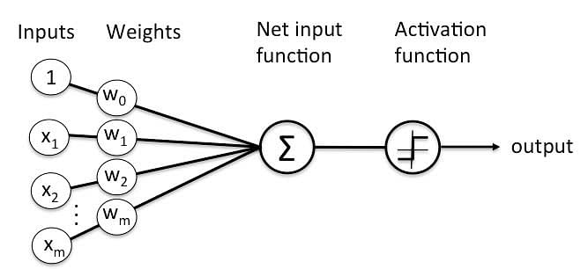
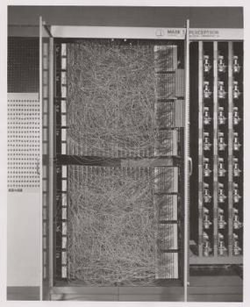
The Perceptron
Invented in 1943 by McCulloch and Pitts, relates a model of neurons to propositional logic
Rosenblatt (1957) generalises the model and develops a learning algorithm
First implemented in 1958
Essentially a linear classifier
First deep multilayer perceptron in 1965

Slide 4
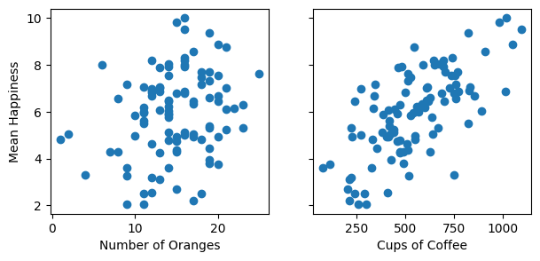
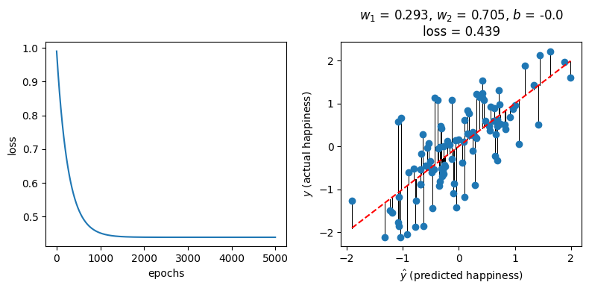
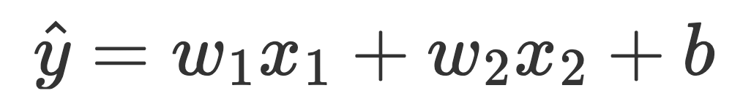
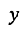
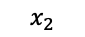
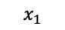
Linear Regression
$$y$$
$$x_{1}$$
$$x_{2}$$

Slide 5
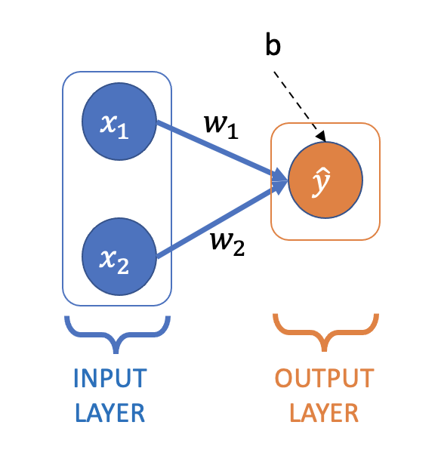
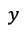
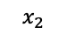
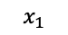
Linear Regression
(in the form of a perceptron)
Weights
Bias
$$y$$
$$x_{1}$$
$$x_{2}$$

Slide 6
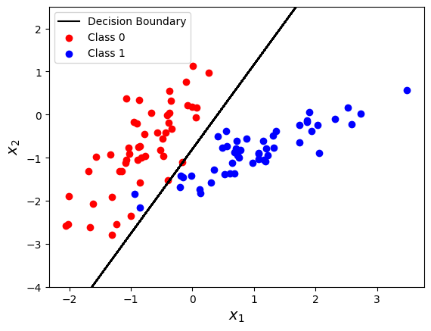
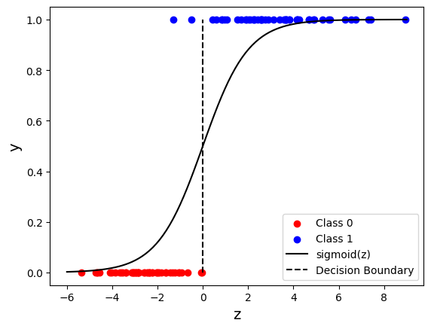



Logistic Regression
(binary classification)
$$z=w_{1}x_{1}+w_{2}x_{2}+b$$
Sigmoid function
$$σ\left(z\right)=\frac{1}{1+e^{−z}}$$
$$\hat{y}=σ\left(z\right)$$

Slide 7
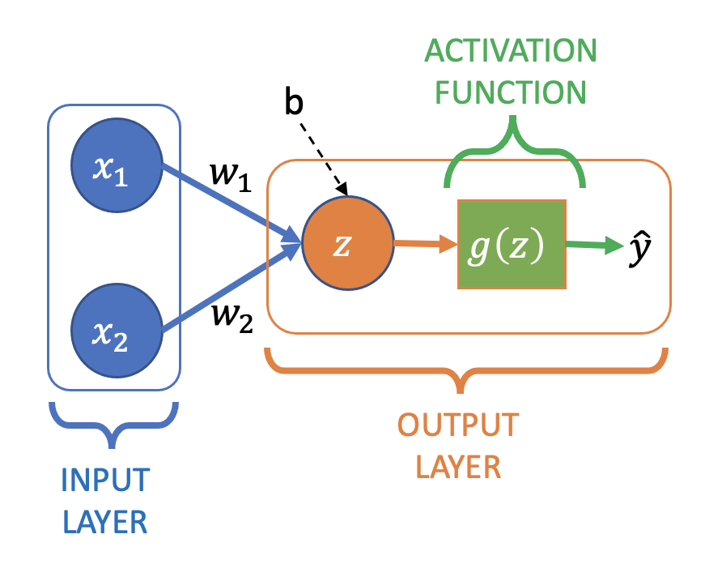
Logistic Regression
(in the form of a perceptron)
Sigmoid function

Slide 8
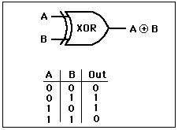
The First ‘AI Winter’
Perceptrons (Minsky and Papert 1969)
Single-layer perceptron can’t solve XOR
Rosenblatt’s algorithm can’t estimate a multi-layer perceptron
BUT: Many misconceptions about this book!
Reaction pushes AI research in other directions for a decade

Slide 9
Comeback: 1980s – 1990s
The solution: backpropagation + gradient descent (we’ll talk more about this in the tech talk)
TLDR: using calculus and the chain rule, pass the error down the network
Some seminal results, e.g. LeCun et al (1989)
But from here on out, you’re more or less up to date

Slide 10
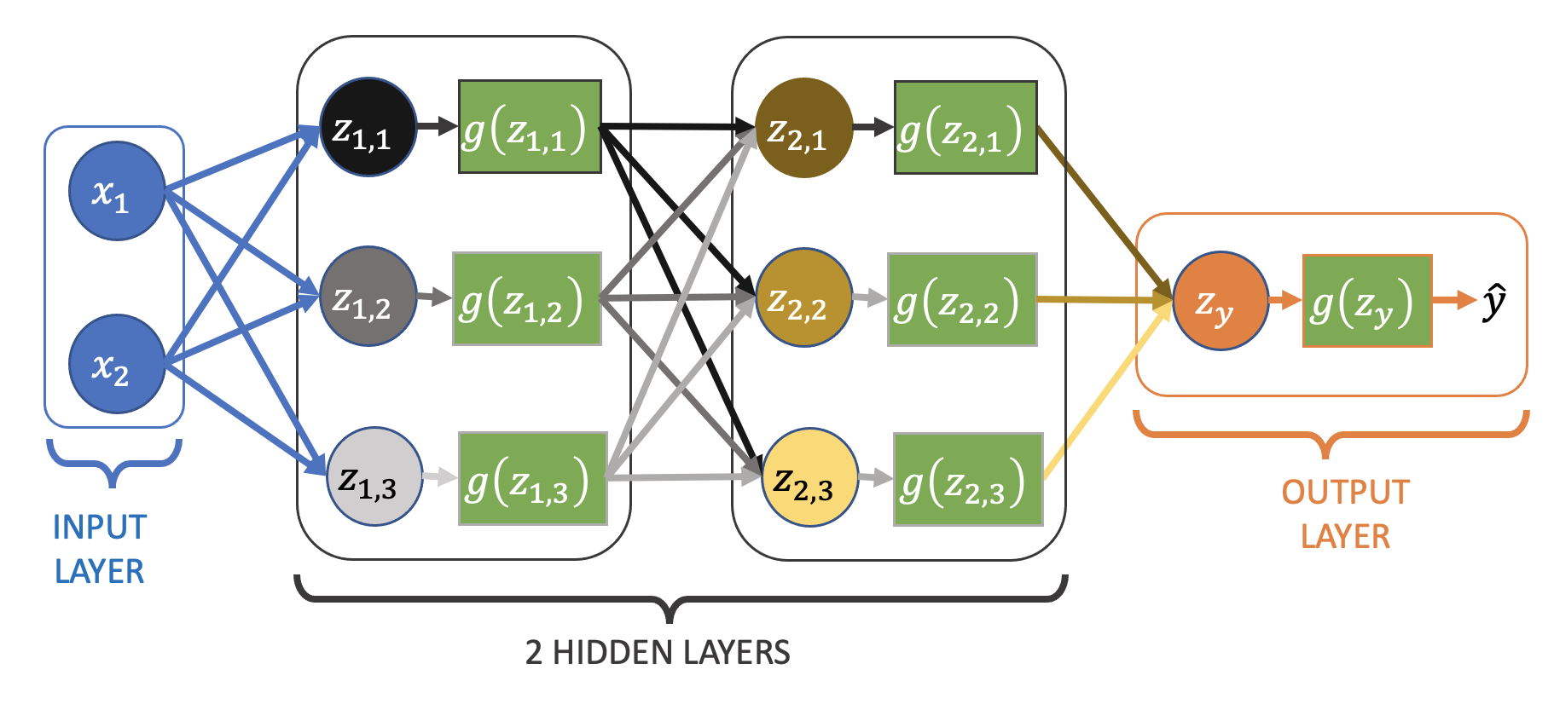
Multilayer Neural Network
(has “hidden” layers)
Also known as:
Multilayer Perceptron (MLP)
Feedforward neural network
Fully-connected neural network
Deep neural network
Each z is a linear combination of the “activations” of the nodes in the previous layer

Slide 11
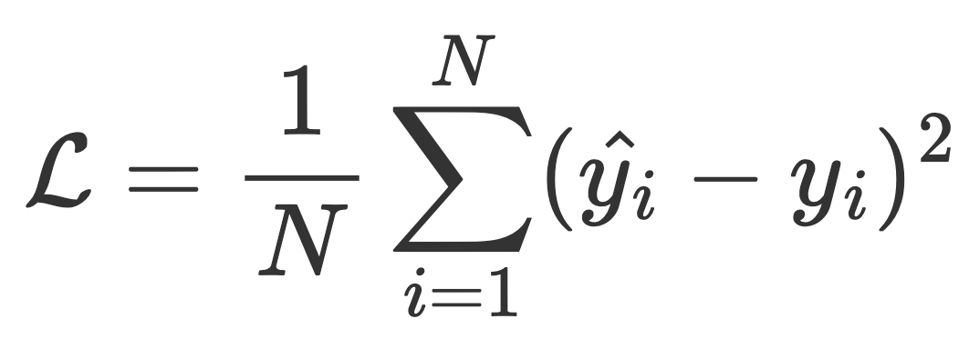
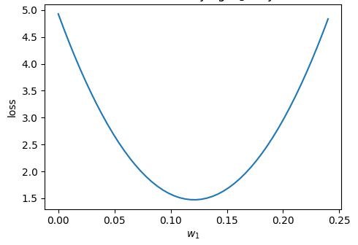
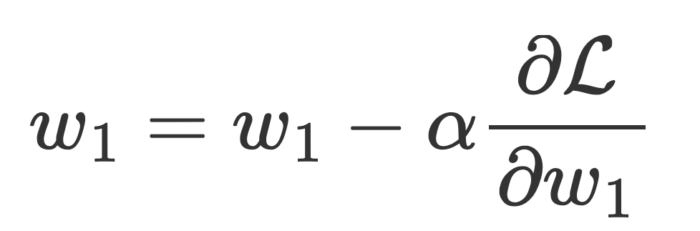
Training Neural Networks
1) Cost function (aka loss function)
2) Gradient descent
e.g.
(for regression)
… for all the weights and biases in the network -> backpropagation
Learning rate
Fig: Urban and Gates 2019

Slide 12
Why do Neural Networks Work Well?
¯\_(ツ)_/¯
Empirically scale well with data (‘emergence’)
Hornik et al (1989): ‘Universal Approximators’
Implicit feature discovery

Slide 13
Present Day Success
Large amounts of data
More powerful computers
GPUs
New, better architectures (more on these later)

Slide 14
Addendum 1: Choice of Activation Function

Slide 15
Activation Functions
Non-linear activation function in hidden layers
Allows deep networks to fit non-linear functions
Task-dependent activation function in output layer, e.g.
Regression: Identity
Classification: Sigmoid (binary), Softmax (multi-class)

Slide 16
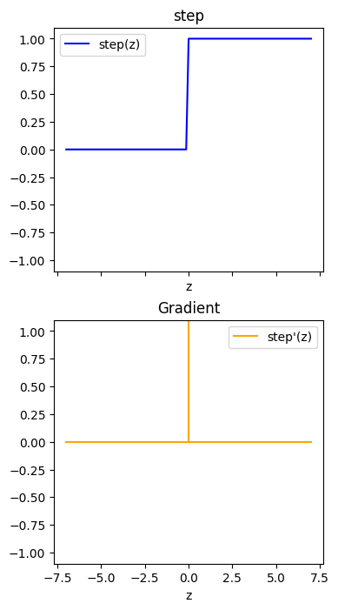
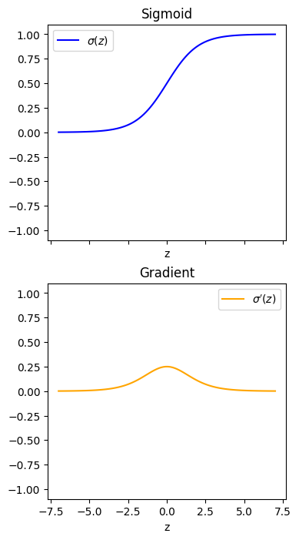
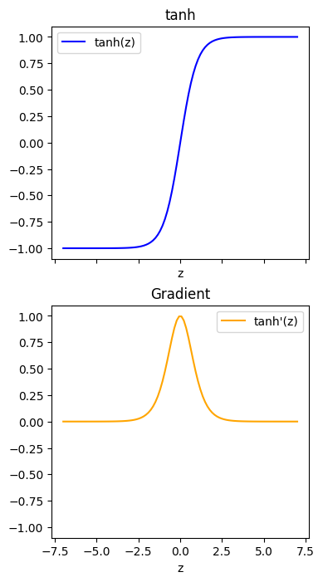
Activation Functions
(that have mostly been superseded by others)
Step
Sigmoid
Tanh
Gradient < 1 for most input values
Backprop multiplies gradients back through the layers
Gradient descent updates become very small (vanishing gradients)
Difficult to train deep networks

Slide 17
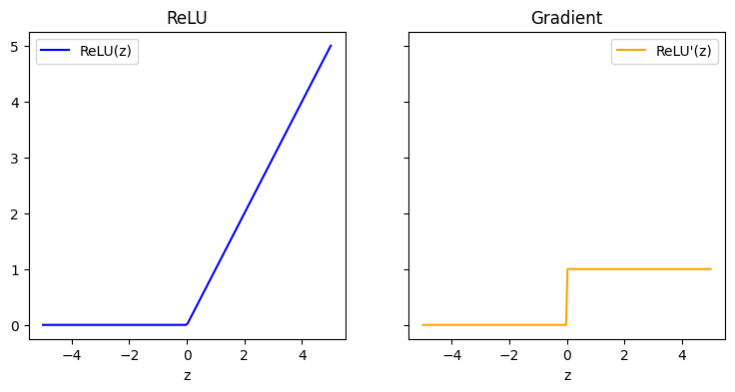

Activation Functions: ReLU
$$f\left(x\right)= \left\{\begin{matrix}x, \\ 0,\end{matrix}\right. \begin{matrix}if x≤0 \\ otherwise\end{matrix}$$
Rectified Linear Unit
Solves some of the problems with sigmoid activation
Simple gradient calculation
No vanishing gradients

Slide 18
Addendum 2: pytorch implementation

Slide 19
https://pytorch.org/tutorials/beginner/basics/quickstart_tutorial.html

Slide 20
Addendum 3: Other Architectures

Slide 21
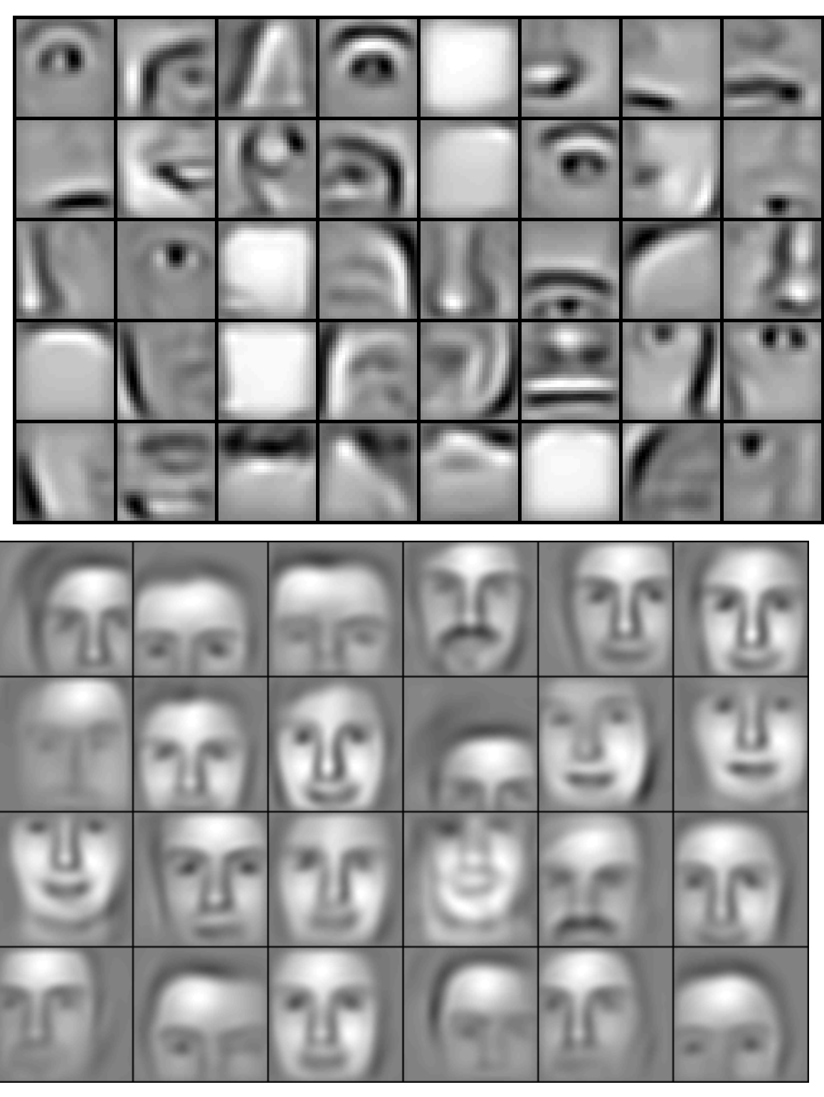

Convolutional Neural Networks (CNNs)
Are not fully-connected – values only depend on some outputs from previous layer (think neighbouring pixels in an image)
Fewer parameters whilst retaining spatial information
Lee et al. (2009) https://doi.org/10.1145/1553374.1553453
Earlier layers
Later layers
https://towardsdatascience.com/a-comprehensive-guide-to-convolutional-neural-networks-the-eli5-way-3bd2b1164a53

Slide 22
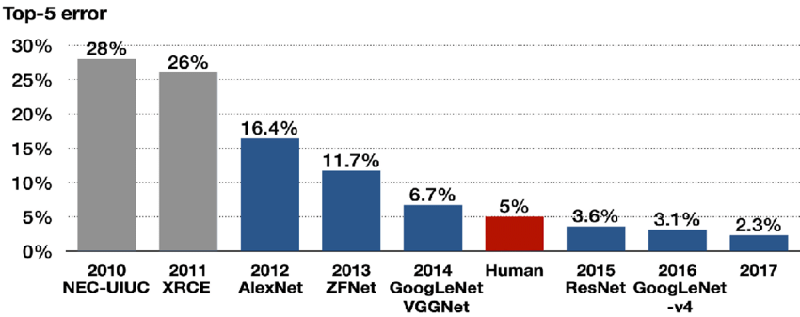
ImageNet Large Scale Visual Recognition Challenge (ILSVRC)
Classify images into 1000 classes
Deep CNNs
Dae-Young Kang, Hieu Pham Duong, Jung-Chul Park. (2020). Application of Deep Learning in Dentistry and Implantology. Implantology, 24(3), 148-181. doi:10.32542/implantology.202015
AlexNet: paper
Introduced ReLU, dropout, image augmentation (last two prevent overfitting)
ResNet: paper
>150 layers, using “skip connections”
Still commonly used (e.g. for transfer learning)

Slide 23
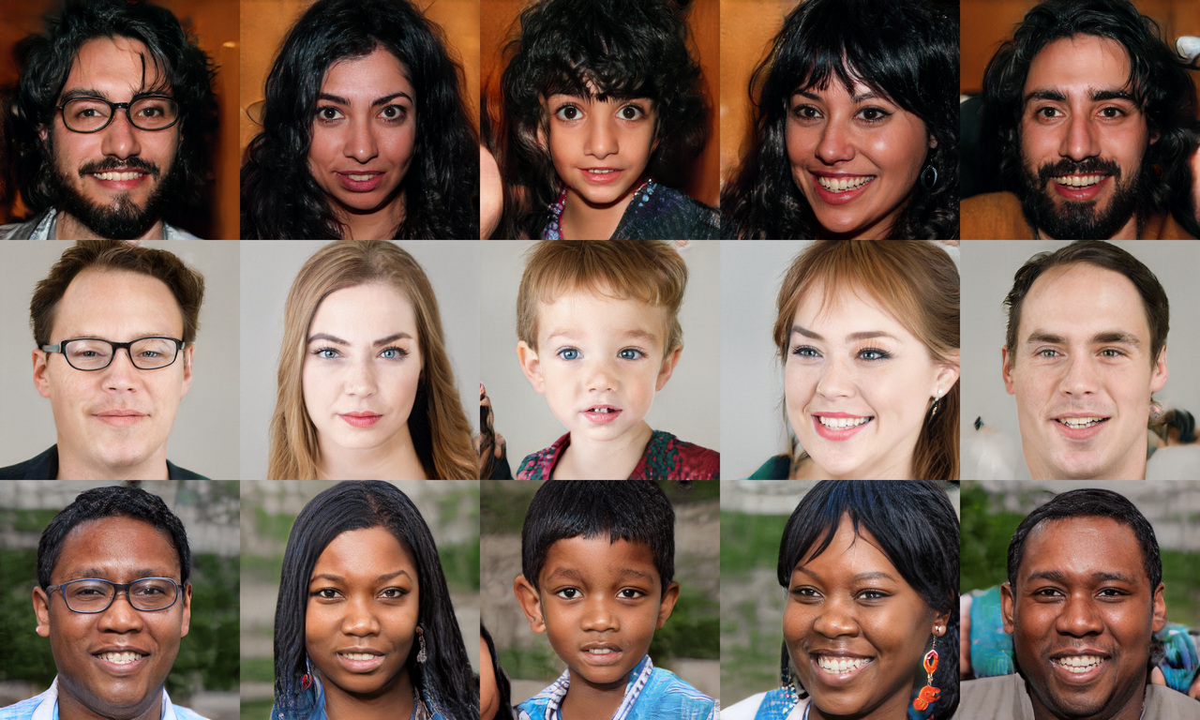
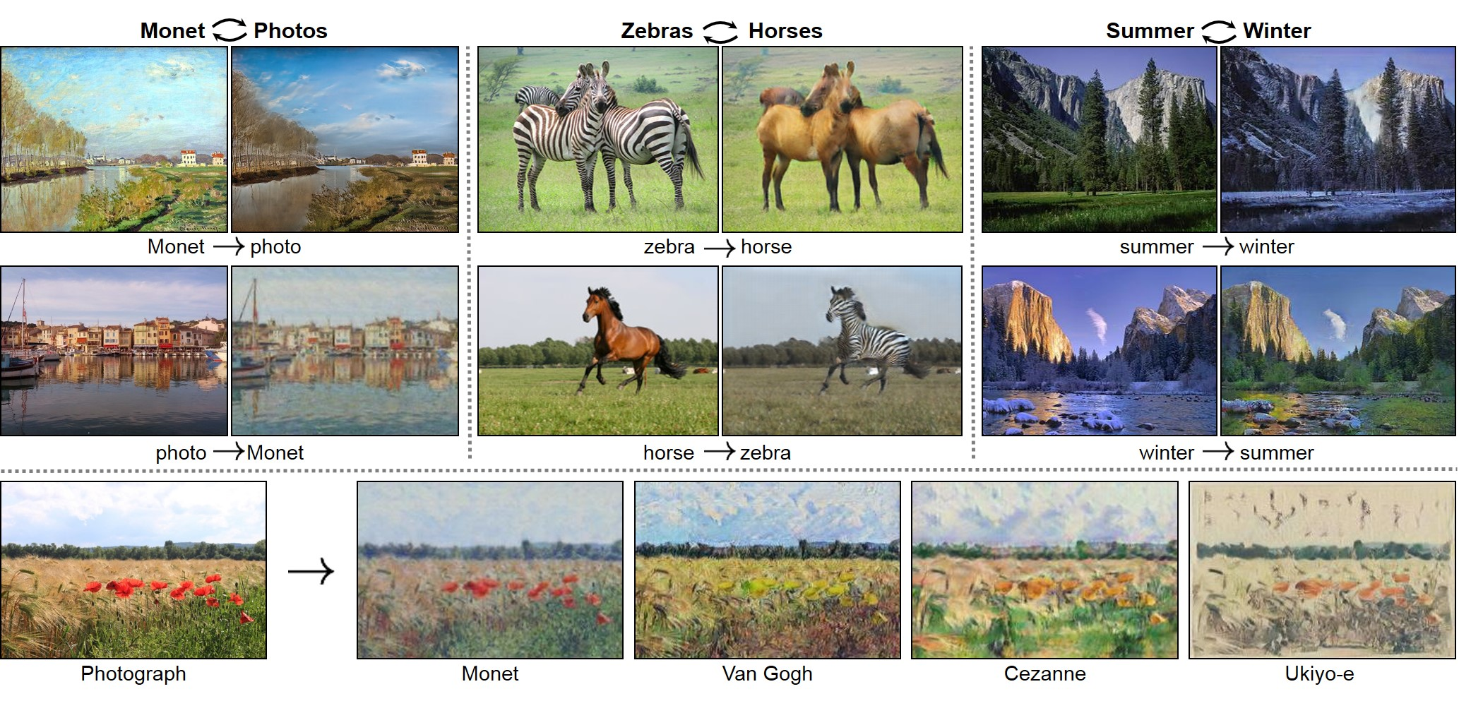
Generative Adversarial Networks (GANs)
Goodfellow (2014): https://arxiv.org/abs/1406.2661
StyleGAN (2018) https://github.com/NVlabs/stylegan
CycleGAN (2017) https://junyanz.github.io/CycleGAN/

Slide 24
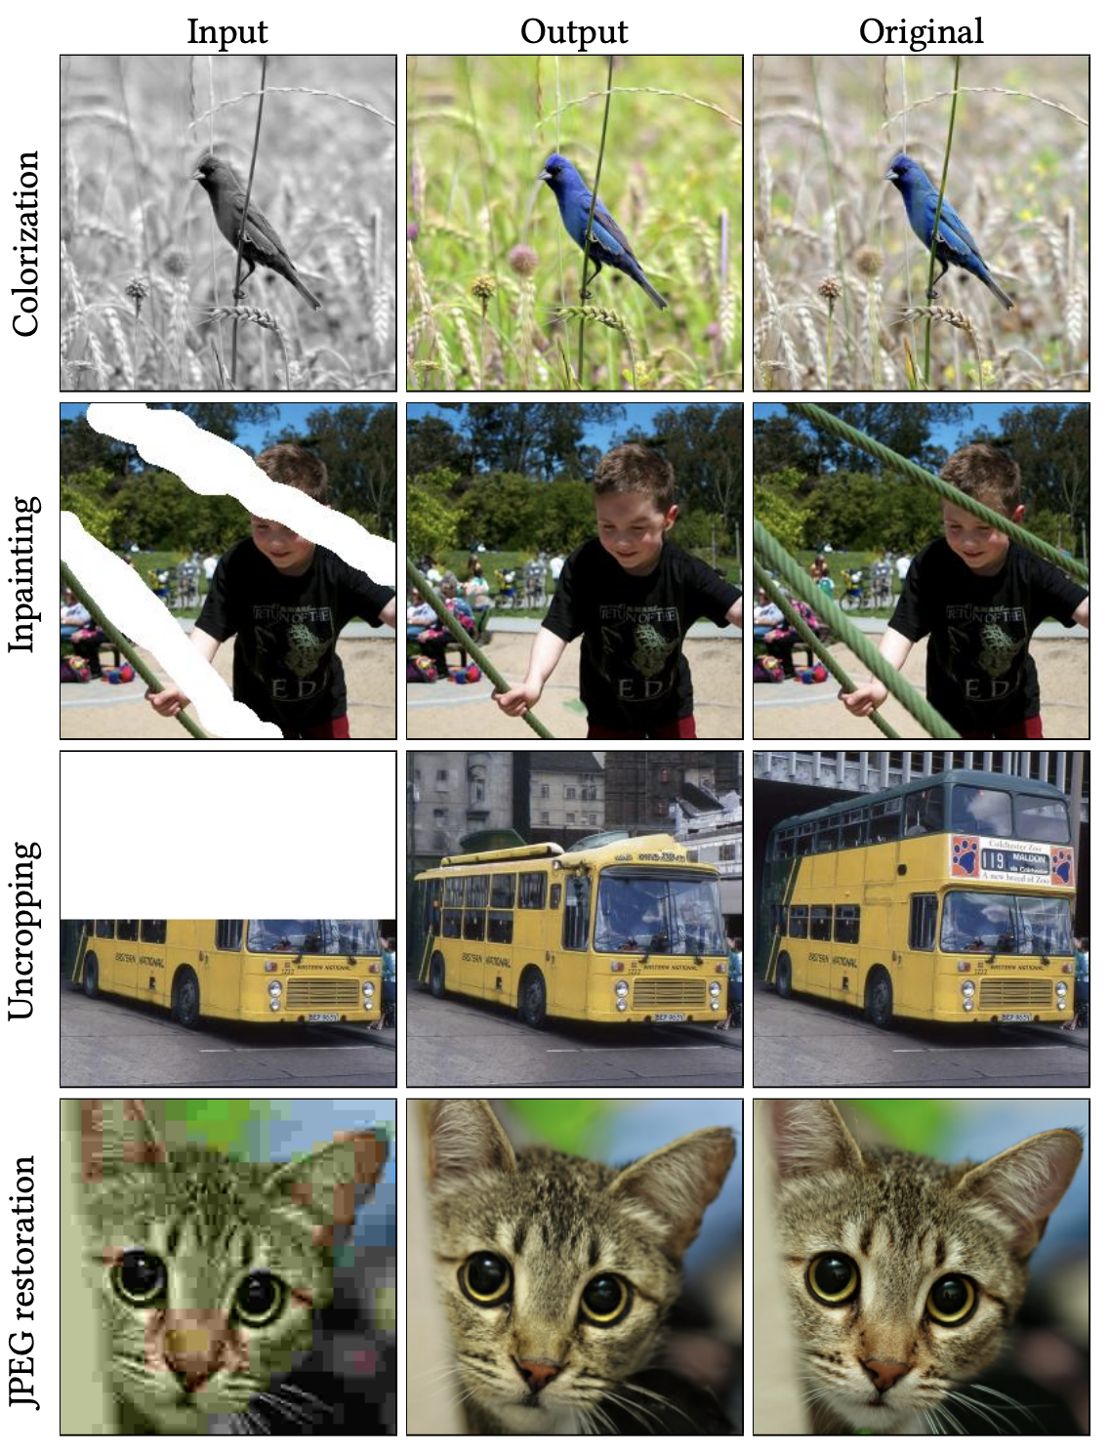

Palette (2022) https://arxiv.org/pdf/2111.05826.pdf
Diffusion Models
Sohl-Dickstein (2015): http://proceedings.mlr.press/v37/sohl-dickstein15.pdf
DALL-E (2021) https://openai.com/research/dall-e
"Teddy bears working on new AI research underwater with 1990s technology"

Slide 25
And more…
Deep Reinforcement Learning
Autoencoders
Graph Neural Networks
Recurrent Neural Networks (RNNs)
Long Short-term Memory (LSTM) networks
Transformers
…
Coming in the next reading group sessions!

